Slide 1
Walk to the Beat of Your Own Drum: The Effects of Self-Selected Music on Responses to Exercise in People with Parkinson’s Disease
Christopher Ballmann, PhD, FACSM
Associate Professor, Director of Resistance Exercise Physiology Lab
Kinesiology ⎮UAB

Slide 2
Conflicts (Not of interest)
I am not a neurologist; I am an exercise physiologist.
I am a classically trained musician.
I am incredibly passionate about exercise.

Slide 3
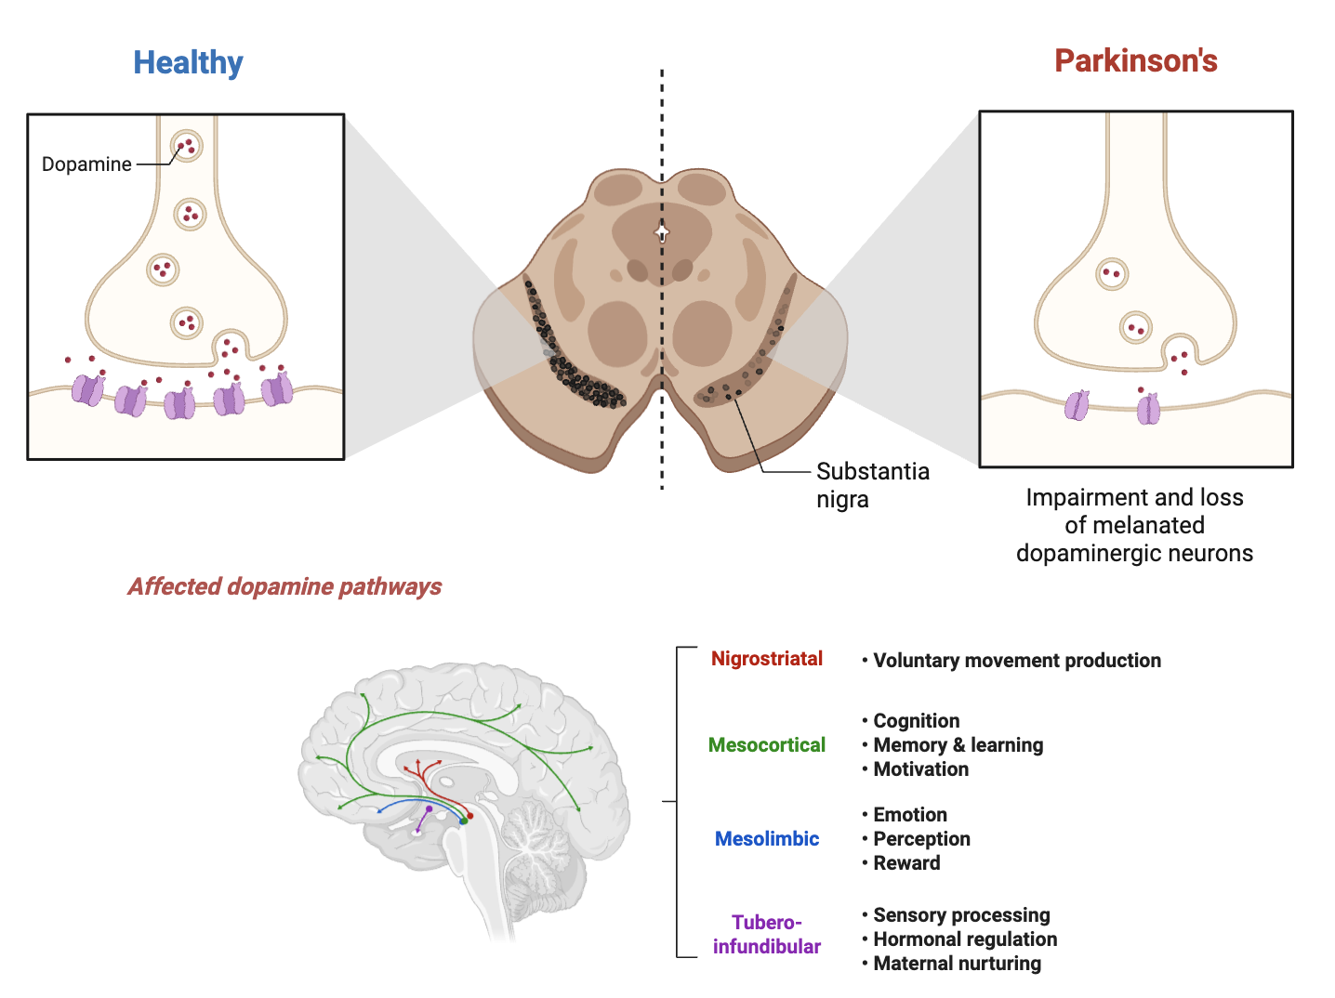


Slide 4
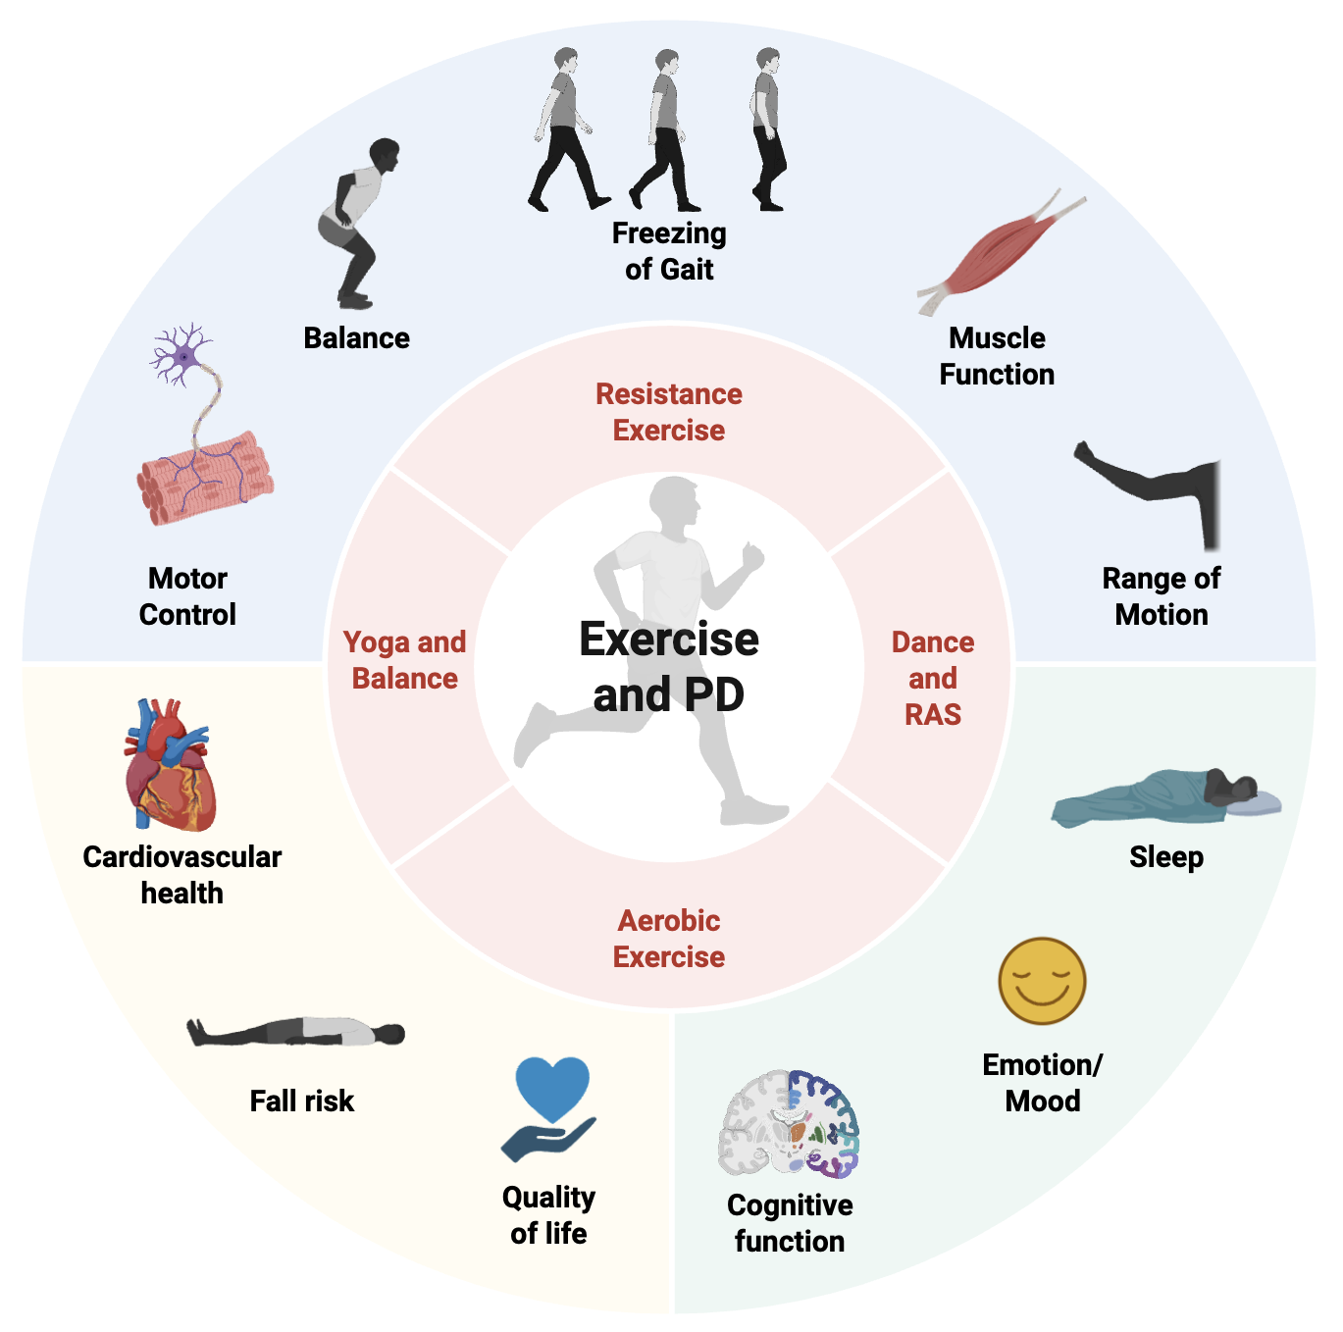
Exercise is among the best therapeutics for PD
Majority of people with PD believe exercise is beneficial. (Prakash, 2021, Mov Disord Clin Pract)
Adherence to exercise in individuals with PD is low. (Afshari, 2017, JPD)

Slide 5
Barriers to Exercise in PD
Physical Symptoms: PD symptoms like tremors, rigidity, and altered gait can make physical activity daunting.
Lack of Motivation: Depression and apathy, common in PD, can reduce the desire to exercise.
Low Energy Levels: Physical and mental fatigue both during and prior to activity can decrease exercise participation and adherence.
(Prakash, 2021, Mov Disord Clin Pract)

Slide 6
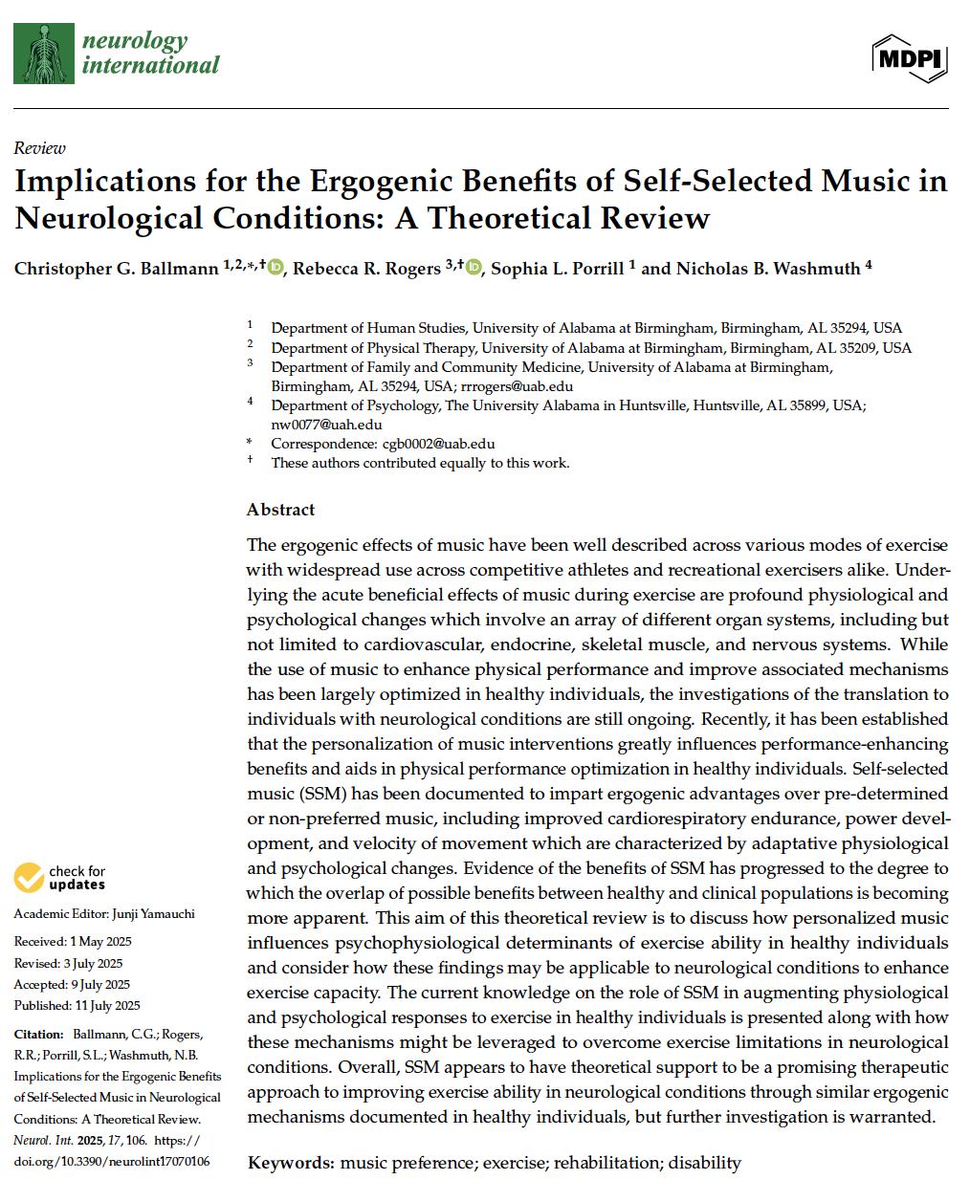
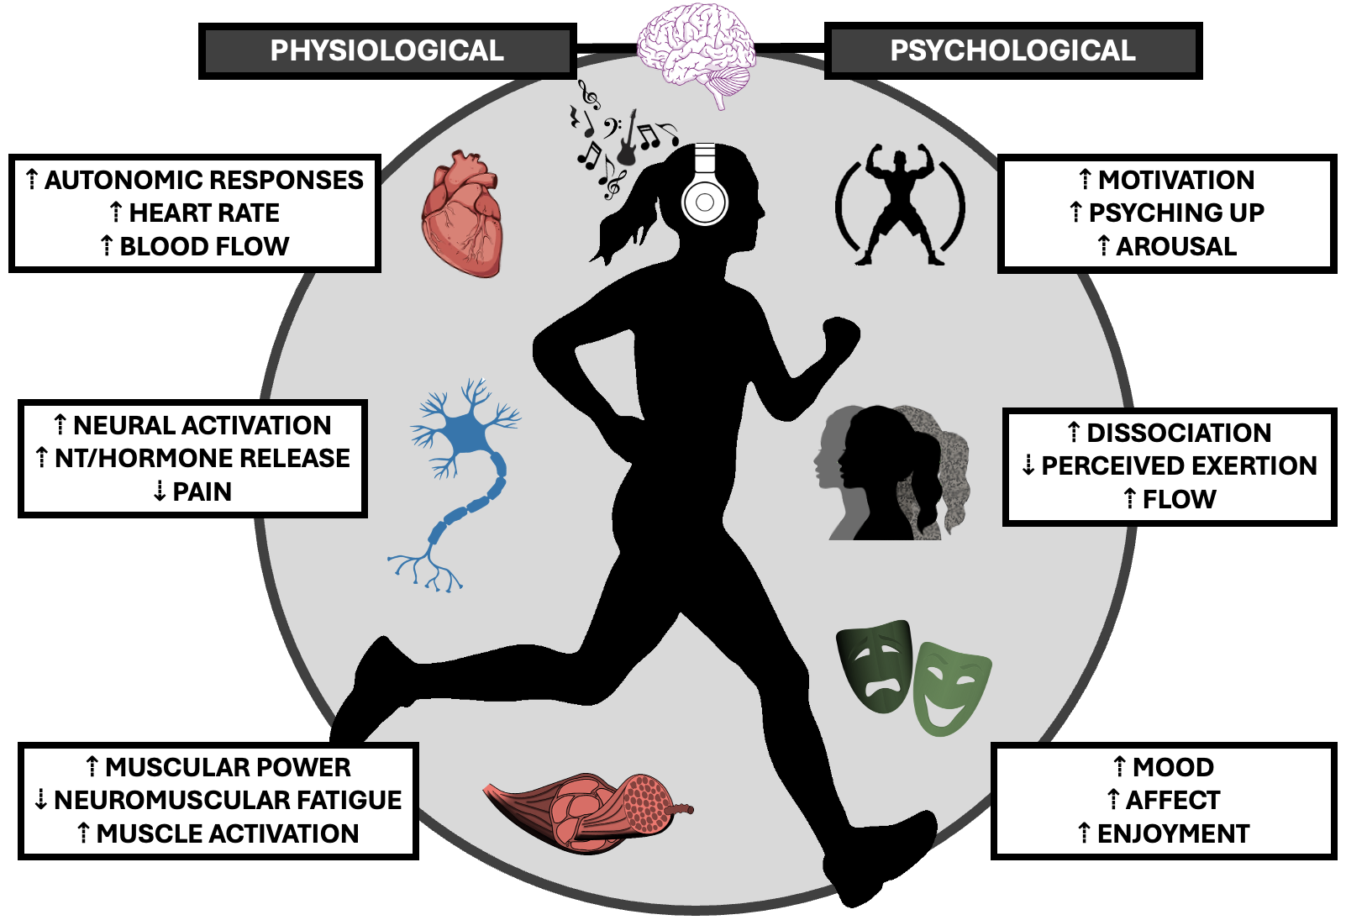
Effects of Self-Selected Music
Ballmann et al. (2025) Neurology International

Slide 7
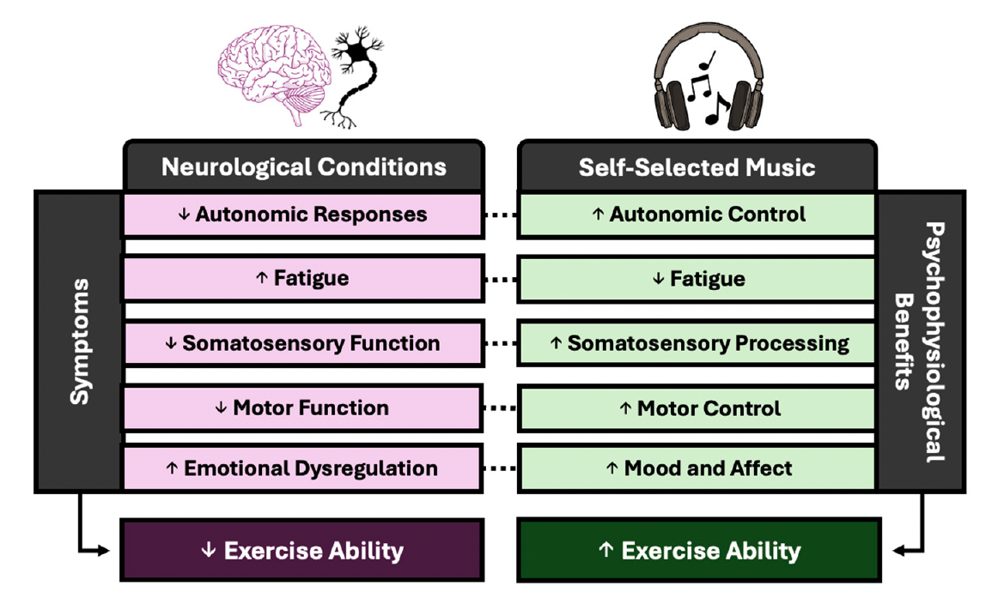
Effects of Self-Selected Music
Can listening to self-selected music help people with PD exercise better?
Ballmann et al. (2025) Neurology International

Slide 8
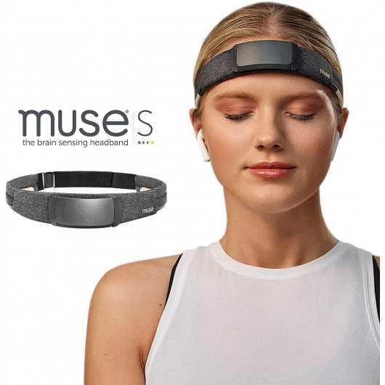

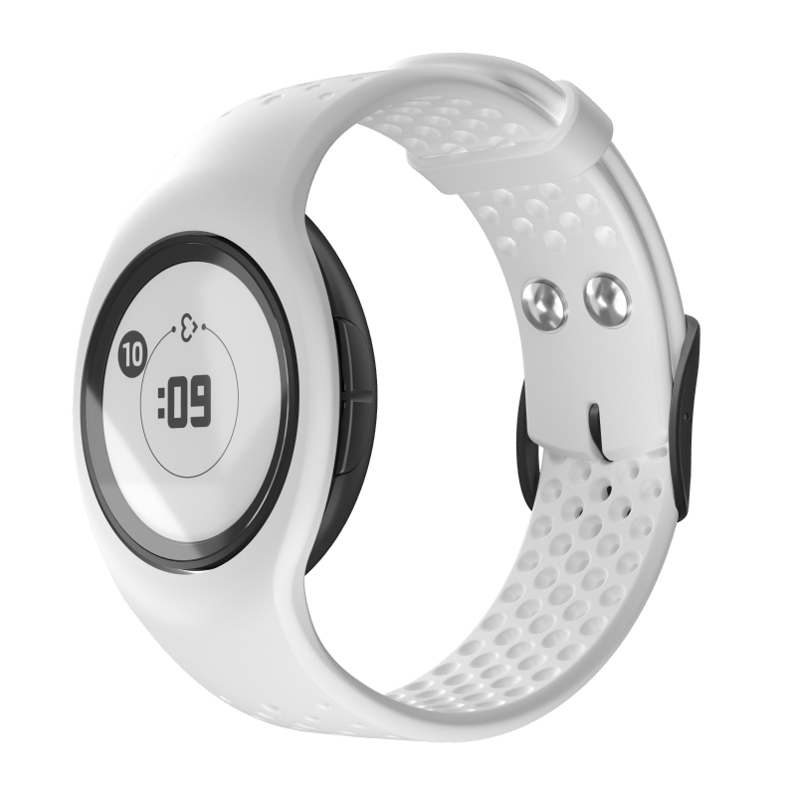
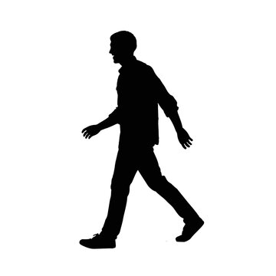

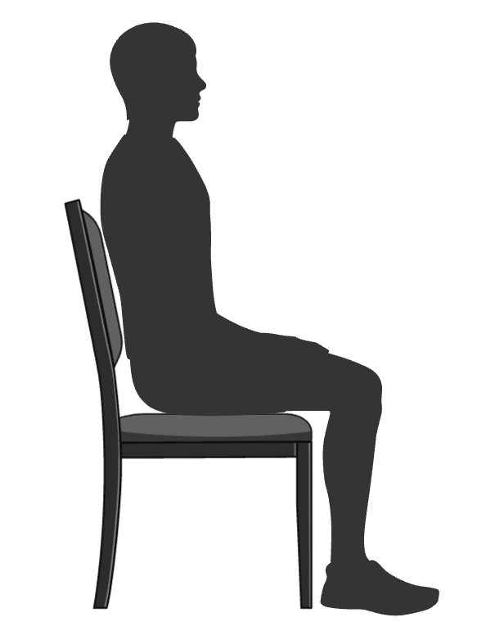
Study Design
5-Minute Rest
6-Minute Walk Test
SIL
WN
WN
SSM
SSM
10 meters
Markers of Arousal
Brain activity (EEG)
Heart rate
Electrodermal activity
Psychological
Motivation
Enjoyment
Arousal
Markers of Capacity
Distance
Steps
Walking Velocity
Markers of Intensity
Heart rate
METs
RPE
Psychological
Motivation
Enjoyment
Arousal
Notes:
Dan Corcos

Slide 9
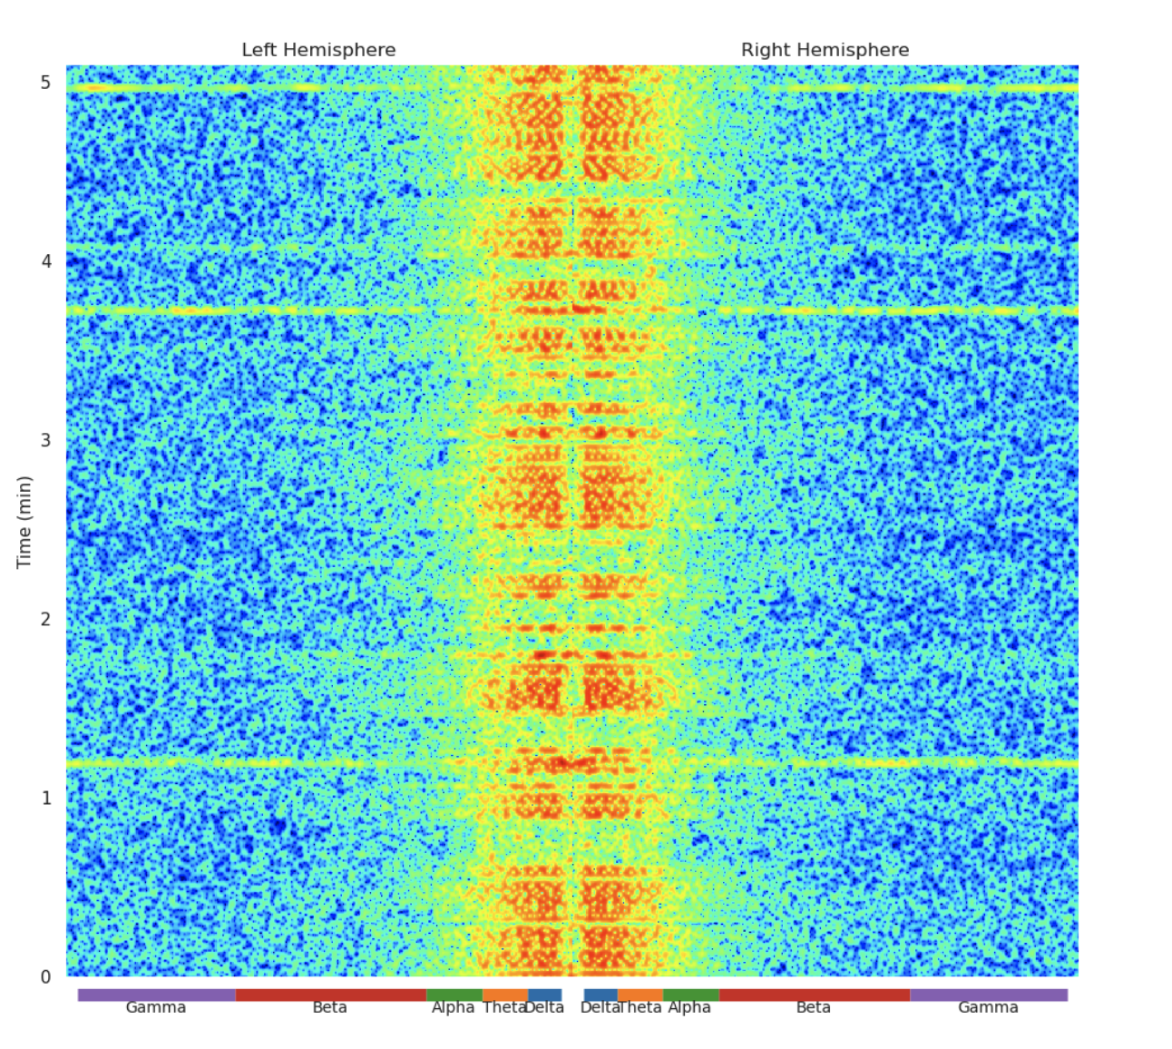
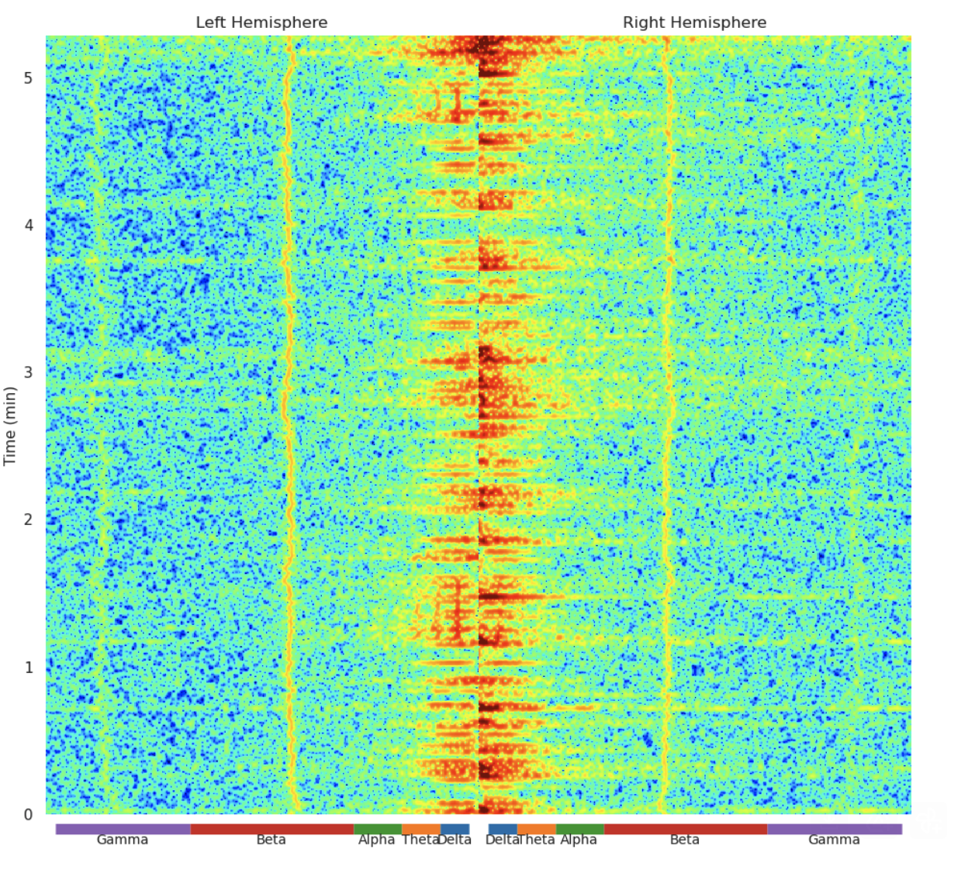
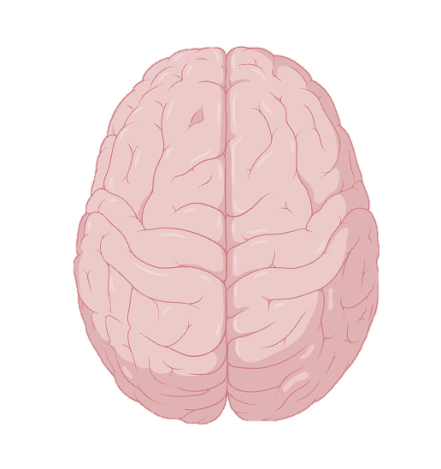


Arousal
β, Ɣ
Relaxed
⍺, ϴ, 𝚫
Arousal
β, Ɣ
Arousal
β, Ɣ
Relaxed
⍺, ϴ, 𝚫
Arousal
β, Ɣ

Slide 10
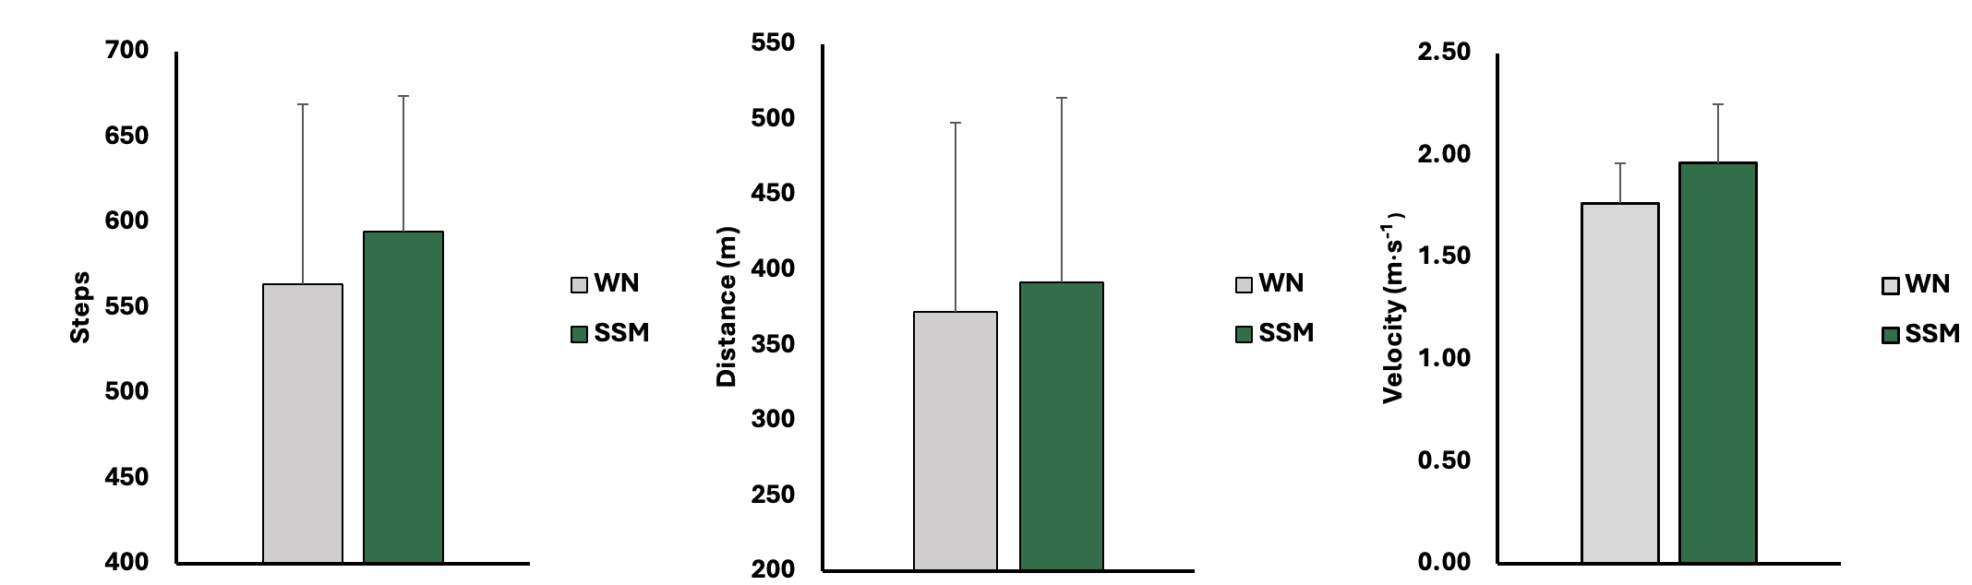
Results – Markers of Exercise Capacity
*
*
*
SSM helps people walk further and faster.
Comparisons of (a) total steps (steps), (b) total distance (m), and (c) walking velocity (m×s⁻¹) between white noise (WN; grey bars) and self-selected music (SSM; green bars) during a 6-minute walk test (6MWT). Data are presented as mean ± SD. * indicates significantly different from WN (p≤ 0.05).

Slide 11
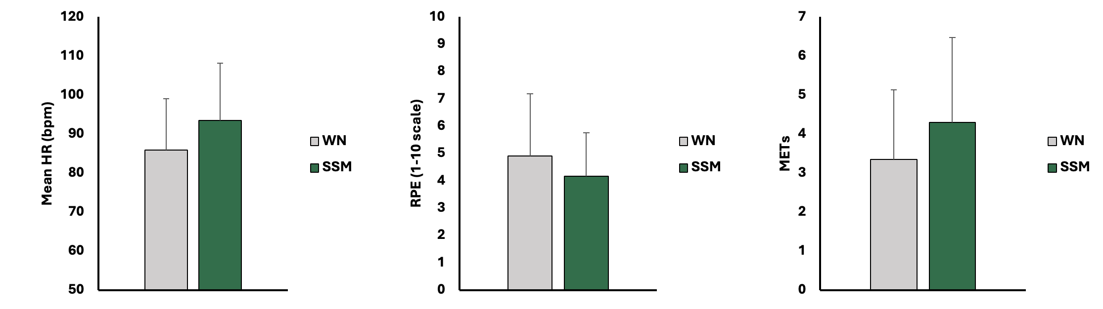
Results – Markers of Intensity
*
SSM increases exercise intensity without perceiving it.
*
Comparisons of (a) mean heart rate (HR; beats per minute), (b) rating of perceived exertion (1-10 scale), and (c) metabolic equivalent of task (measure of energy used during physical activity) between white noise (WN; grey bars) and self-selected music (SSM; green bars) during a 6-minute walk test (6MWT). Data are presented as mean ± SD. * indicates significantly different from WN (p≤ 0.05).

Slide 12
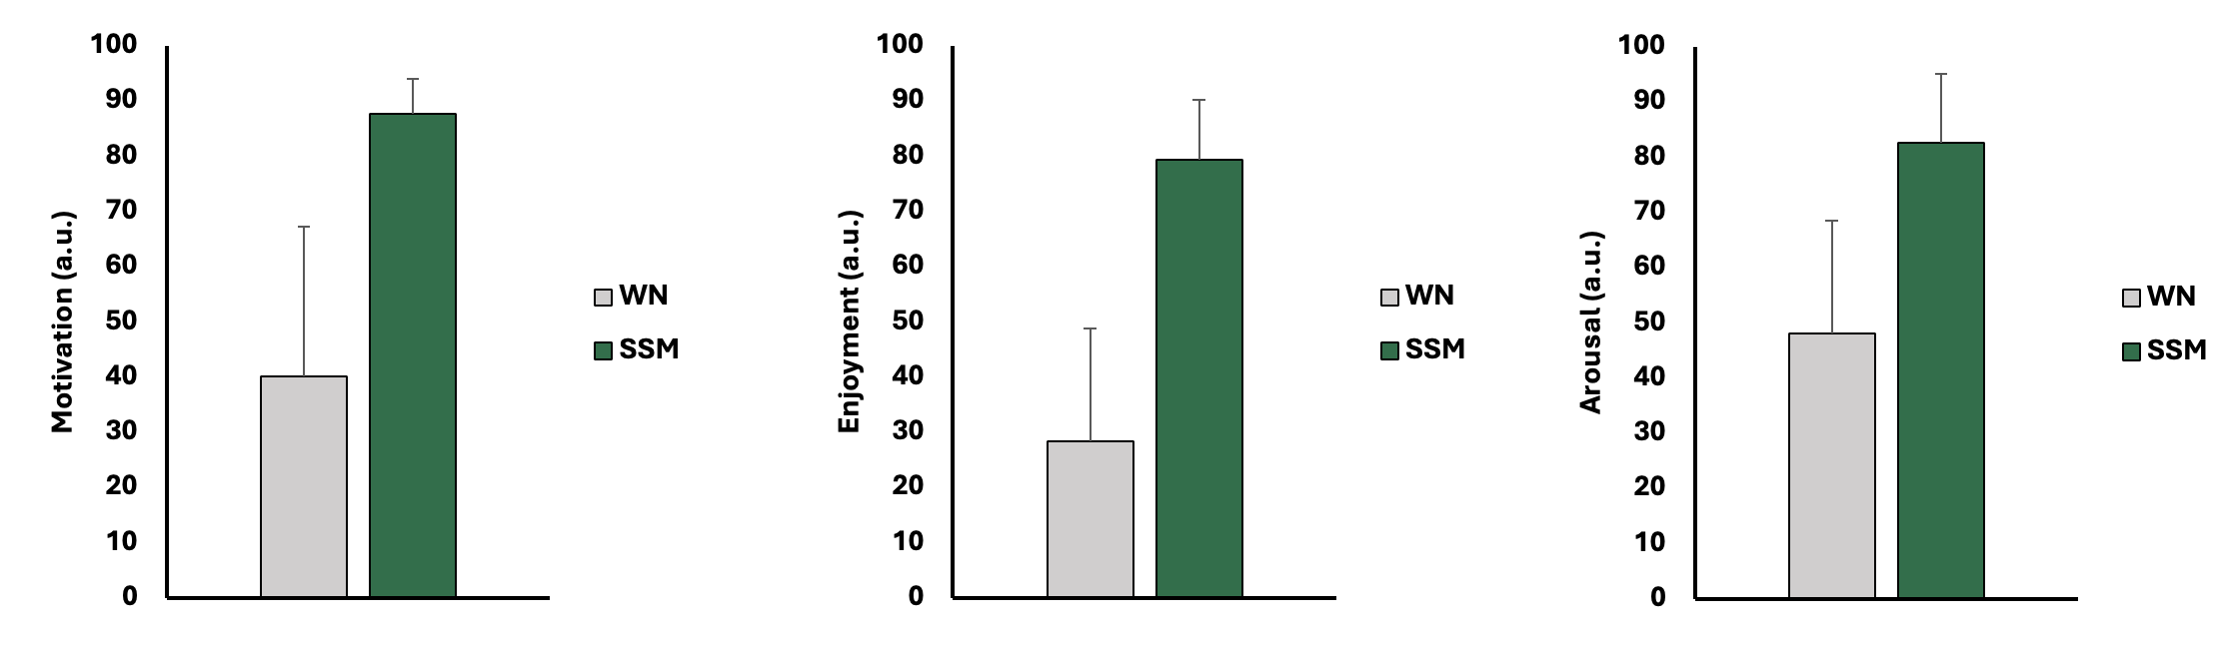
Results – Psychological
*
*
*
SSM enhances psychological determinants of exercise capacity.
Figure 5. Comparison of (a) motivation (arbitrary units; a.u.), (b) enjoyment (arbitrary units; a.u.), and (c) arousal/readiness to give effort (arbitrary units; a.u.) between white noise (WN; grey bars) and self-selected music (SSM; green bars) during a 6-minute walk test (6MWT). Data are presented as mean ± SD. * indicates significantly different from WN (p≤ 0.05).

Slide 13
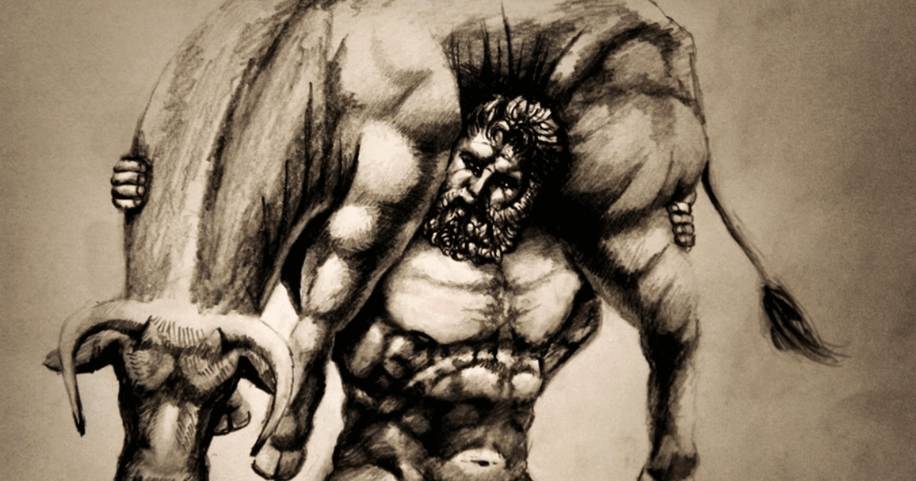
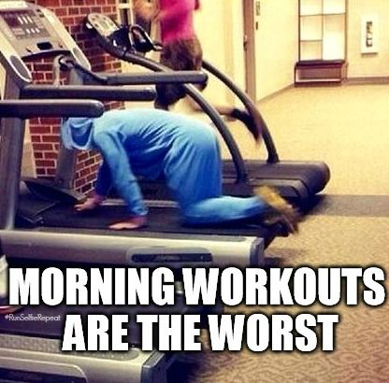
Practical Applications and Conclusions
SSM allows for increased walking capacity and higher intensities.
  May lead to greater adaptation over time.
  Improved perceptive and psychological responses may have implications for adherence.
SSM results in enhanced motivation and psychological outcomes.
  May aid in overcoming PD-associated losses in motivation and emotional dysregulation.
  Possibly aid in initiation of exercise or daily tasks.

Slide 14
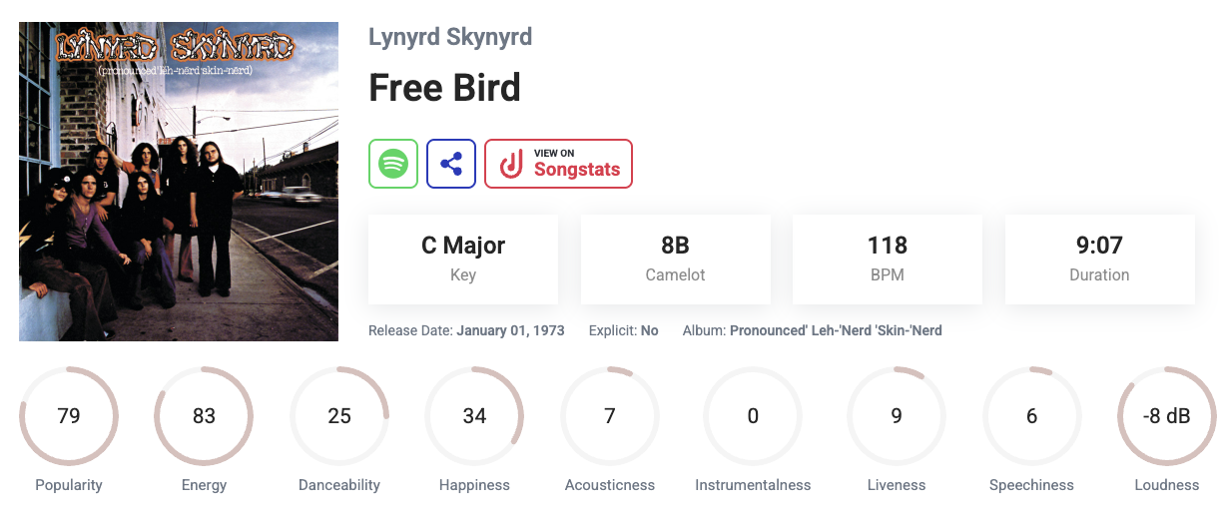



Practical Application- What Can You Do?
How to apply this information:
  Music characteristics matter
    Ex. Faster tempo= more stimulative
  Curate playlists for quick and easy implementation to combat symptoms (AI can help).
    Ex. Relaxing music if feeling anxious
  Task specific implementation
    Ex. Sleep versus exercise
  Sing or “drum” to the beat
Tunebat.com

Slide 15
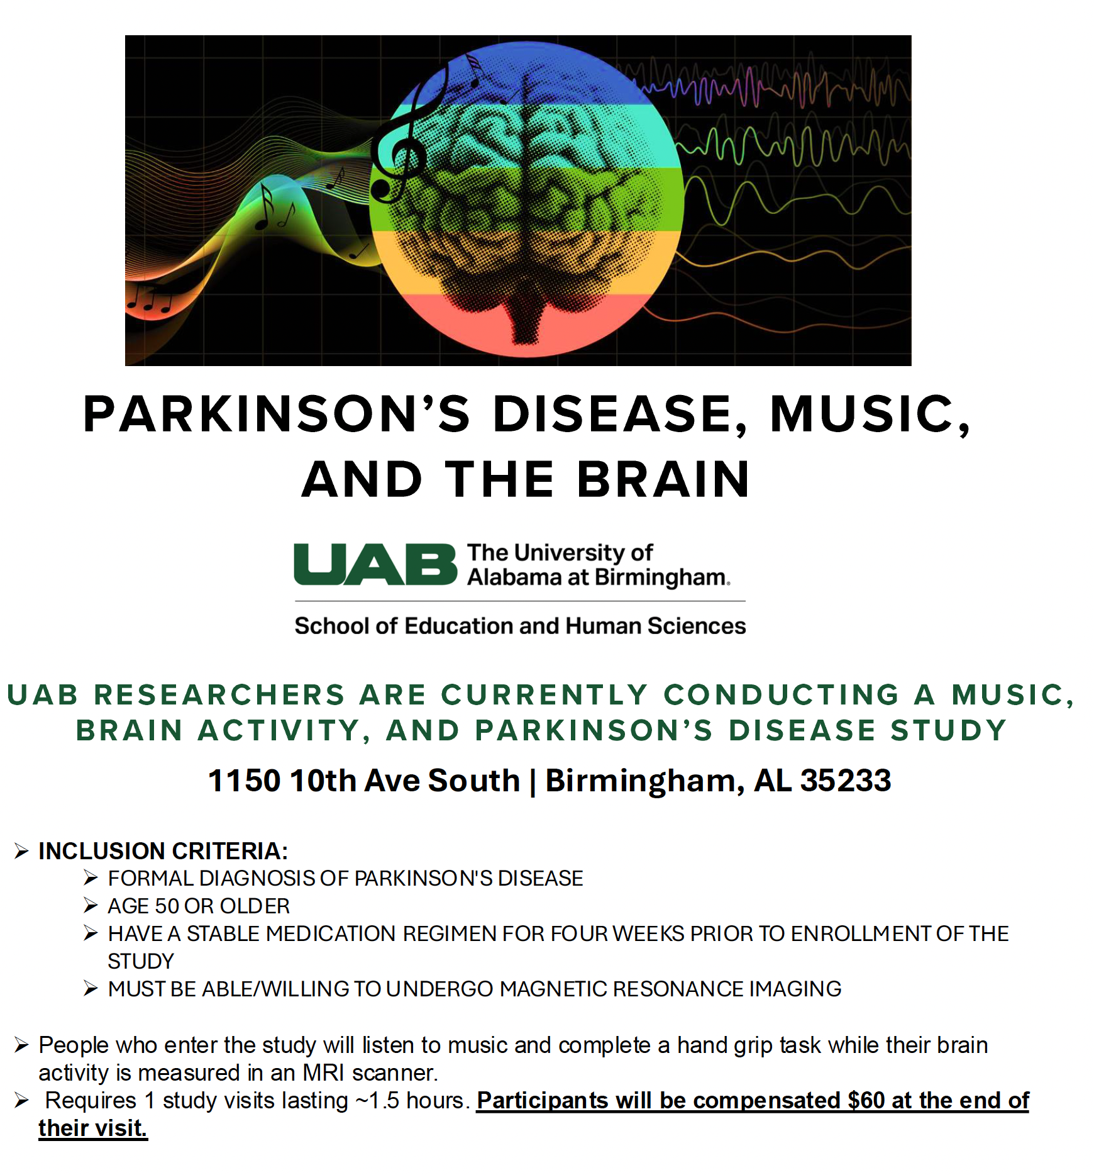
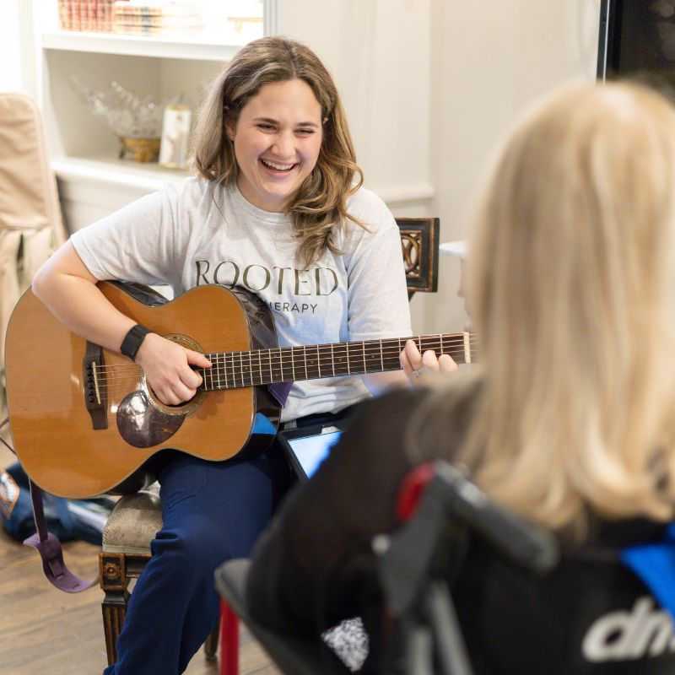

Ongoing Research

Slide 16
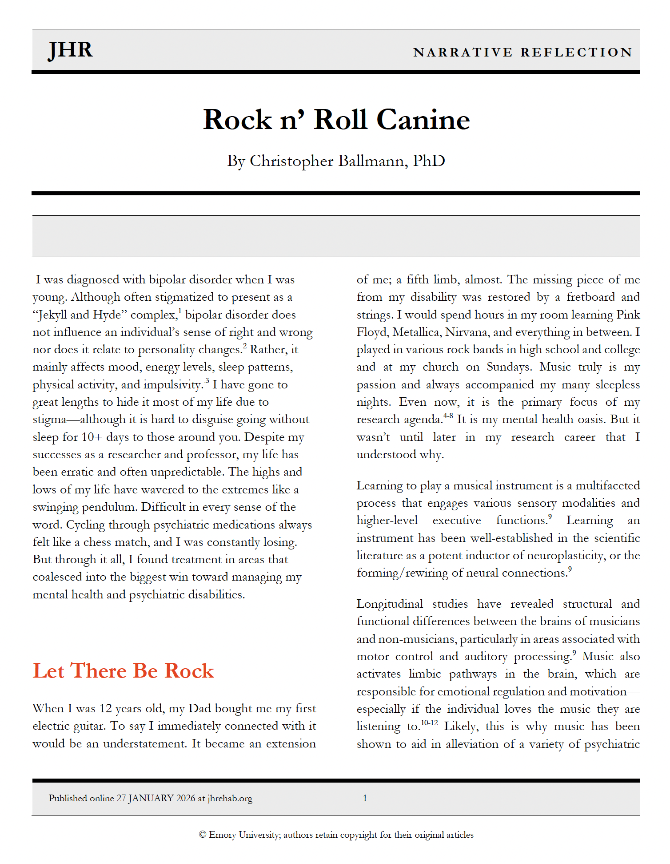

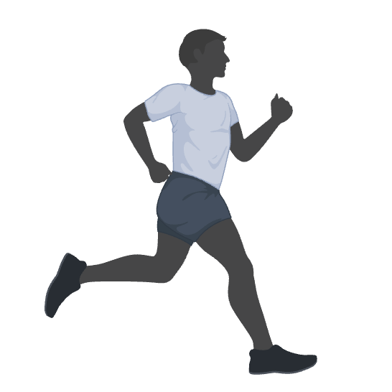
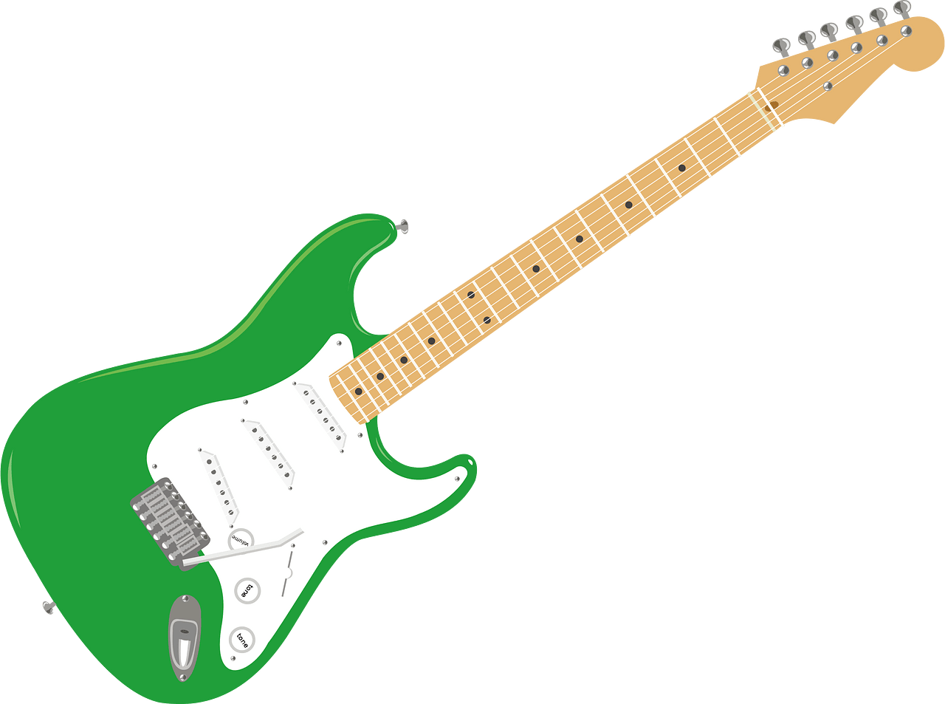
Why Parkinson’s Disease?
482% increased risk for developing PD (Huang, 2019,Neurology).
235% increased risk for developing PD (Faustino, 2020, JAMA).

Slide 17
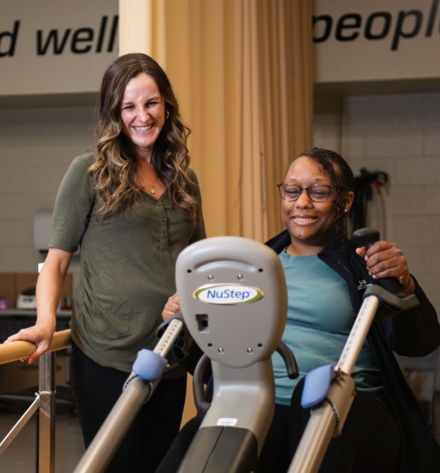



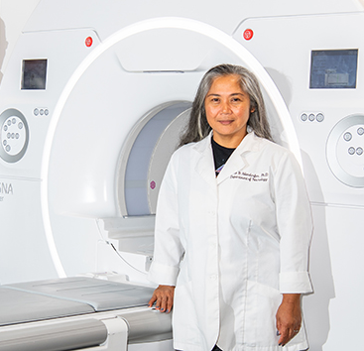
Acknowledgments
Graduate Students
Sophia Porrill, MS
Haley Nguyen
Collaborators
Alex Evancho, DPT
Jane Allendorfer, PhD
Christine Ferguson, PhD, RD, CSG
Rebecca Rogers, MS
James Rimmer, PhD
David Standaert, MD, PhD
Hannah Oakes, MT-BC, NMT

Slide 18

Thank you!

