Slide 1
Update on Parkinson Disease Research
Alabama Udall Center
Parkinson Association of Alabama
November 9, 2021

Slide 2
Parkinson disease: Three big questions
What causes Parkinson disease?
How can we treat the symptoms?
How can we slow or prevent disease progression?

Slide 3
PD is common. Age is the primary risk factor
200
180
160
140
120
100
80
60
40
20
0
Overall
Male
Female
Incidence per 100,000
2018
49M
0-29 30-39 40-49 50-59 60-69 70-79 80+
Age in years
Kaiser Permanente, 1994 -1995 (Van Den Eeden et al, Am J Epidemiol 2003; 157:1015-1022)
Parkinson disease today affects about 1M in the US, about 7-10M worldwide.
The prevalence is increasing rapidly because of aging of the population.

Slide 4
Genetics
Genetic studies continue to grow more powerful.
More than 100 genes linked to PD, most with a small effect
Strongest signals:
Alpha-synuclein
LRRK2
GBA
New efforts to expand the diversity of participants in genetic studies
5-year program to genotype 150,000 volunteers
BLAAC-PD
LARGE-PD

Slide 5
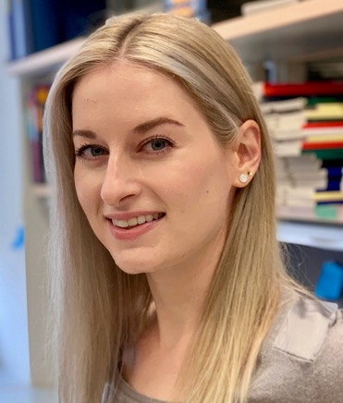
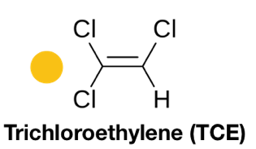
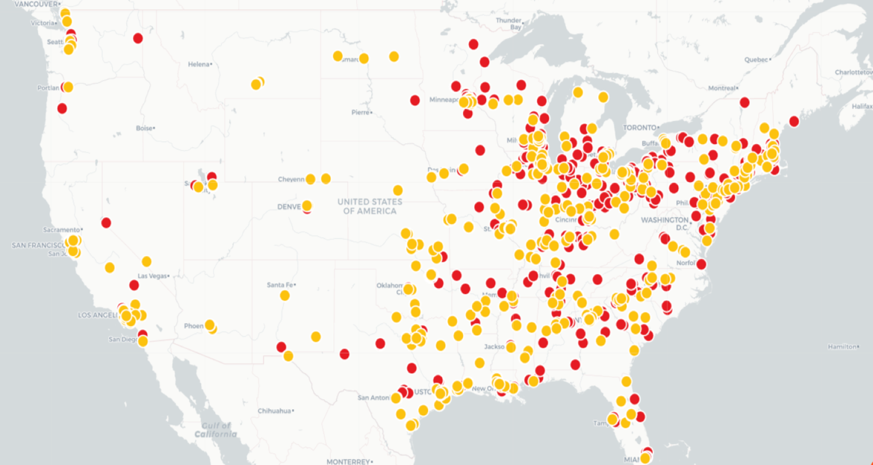
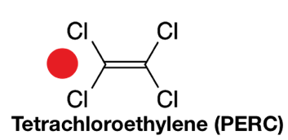
Environmental Factors in PD
Environmental Contamination with TCE and PERC:
toxins linked to PD risk
PD Odds Ratio 6.1 (95% CI: 1.2-33)
p = 0.034
N=9
Briana De Miranda, PhD
PD Odds Ratio 10.5 (95% CI: 0.97-113)
p = 0.053
N=5
Goldman et al., 2011
Toxics Release Inventory, US EPA 2018

Slide 6
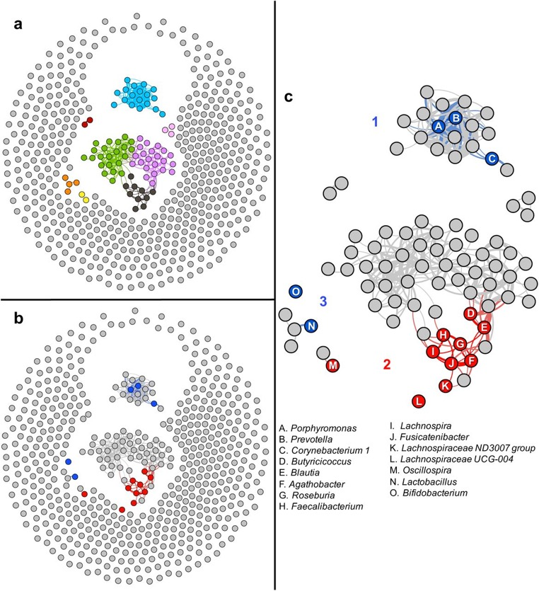
role of the microbiome
The microbiome is the colony of organisms that live together with us on our skin, and in our gut
Studies from Zach Wallen and Dr. Payami show an overabundance of opportunistic pathogens in PD
Are gut organisms a trigger for PD, or a consequence?
doi: https://doi.org/10.1101/2020.01.13.905166

Slide 7
New treatments
Recently approved drugs:
Istradefylline – A2a antagonist for wearing off (Nourianz®)
Safinamide – MAO inhibitor (Xadago ®)
Inhaled levodopa (Inbrija®)
Sublingual apomorphine (Kynmobi®)
Opicapone – COMT inhibitor (Ongentys®)
New Technologies
Directional Deep Brain Stimulation
Focused ultrasound

Slide 8
Slowing or Preventing disease progression
Anti-Synuclein strategies
Antibody infusions are in clinical trials
Treatments to prevent aggregation, or enhance clearance
LRRK2 Inhibitors
Currently in early human trials
Anti-inflammatory treatments
Focus of the Alabama Udall Center

Slide 9
Alabama Udall Center Innate and Adaptive Immunity in Parkinson Disease
A Morris K. Udall Center of Excellence in Parkinson's Disease Research
NIH Award P50NS108675

Slide 10
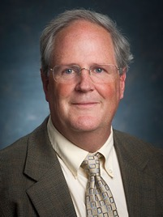
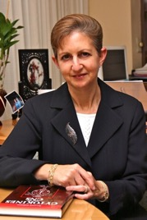
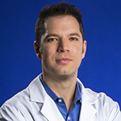
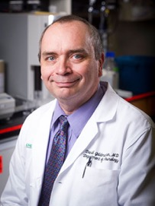
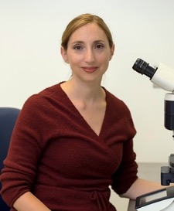
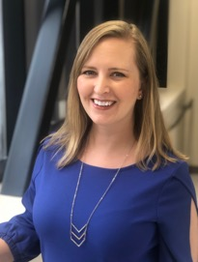
Key Personnel and timeline
Alabama Udall Center
David Standaert
Program Director
Project 1
Admin Core
Tika Benveniste
Project 2
Andy West
Project 3
David Geldmacher
Project 4
Talene Yacoubian
Clinical Core
Laura Volpicelli-Daley
Animal Model Core
Katherine Belue
Administrator
Year 1 “Start”
July 1, 2018
First subject
11/9/2018
2019 EAC
8/27/2019
2021 Udall Center Retreat
Year 1
Year 2
Year 3
Year 4
Year 5
Notice of Award
9/18/2018

Slide 11
Clinical Core Progress
Goals
Recruit, clinically assess, and follow longitudinally 60 subjects with early stage, untreated PD and 60 controls
Collect biological specimens
Obtain [¹⁸F]DPA-714 PET imaging to assess central inflammation
Submit data to DMR and deposit biosamples at BioSEND
Total Enrolled as of 10/12/2021 – 114
Baseline + 12M0 F/U – 60
Baseline + 24MO F/U – 32
HC: 57
PD: 57

Slide 12
Udall Center Goals
We are looking for evidence of immune activation in early PD
We have recruited nearly all of the 120 PD patients and controls that we need, and will have detailed data on their symptoms and measures of immune activation
We want to discover the relationship between immune activation and progression of PD
Our studies in cells and animal models suggest that drugs which block either the “JAK/STAT” pathway or the “LRRK2” pathway may reduce inflammation in PD
We hope that our studies pave the way for testing anti-inflammatory treatments to slow or stop the progression of PD

Slide 13
Alabama Udall Center team
Admin Core
Katherine Belue, Richard Kennedy
Project 1
David Standaert
Hongwei Qin
Samantha Carlisle
Ed Griffin
Jonathan McConathy
Eliot Lefkowitz
Curtis Hendrickson
Ashley Harms
Asta Jurkuvenaite
Project 2
Tika Benveniste
Hongwei Qin
Jessica Buckley
William Turbitt
Lianna Zhou
Huixian Hong
Project 3
Andrew West
Zhiyong Lui
Arpine Sokratian
Enquan Xu
Project 4
David Geldmacher
Shelby Collins
Clinical Core
Talene Yacoubian
Roy Alcalay
Amy Amara
Adam Gerstenecker
Natividad Stover
Allen Joop
Lauren Ruffrage
Christopher Collette
Itzel Mendoza
Animal Models Core
Laura Volpicelli-Daley
Drake Thrasher
Sean Coyle
Marissa Menard
Internal Advisory Committee
Anupam Agarwal
Matthew Goldberg
Haydeh Payami
Fran Lund
External Advisory Committee
Thomas Montine
Rachel Saunders-Pullman
David Sulzer
Darren Moore
Ken Cater

Slide 14
What will the PD therapy of the future look like?
Prodromal
“Pre-PD”
Early PD
Advanced PD
At-Risk
PD Prevention
Gene Specific Therapies (GBA, LRRK2)
Anti-Synuclein Therapies
Exercise
Anti-inflammatory therapies
Levodopa and other dopamine medications
DBS and other Surgical
14

Slide 15
UAB clinical trials in PD
https://www.xpertdox.com/uab-trial/
A Clinical Study of NLY01 in Patient's With Early Parkinson's Disease
Slow Wave Sleep as a Biomarker of Rehabilitation-induced Cognitive Improvement in PD
PPMI 2.0 Clinical -Establishing a Deeply Phenotyped PD Cohort
BLAAC-PD
A Study to Evaluate the Efficacy and Safety of Intravenous Prasinezumab in Participants With Early Parkinson's Disease
UAB Movement Disorders 205-934-0683

Slide 16
Questions and Answers

