Slide 1
Nutrition for Sleep & Parkinson’s Disease
Christine C. Ferguson, PhD, RD, CSG
cfergus2@uab.edu

Slide 2
Sleep Disorders & PD
Up to 88% of people with PD have a sleep disorder¹
  Sleep fragmentation, REM sleep behavior disorders, daytime sleepiness, insomnia
Medication side effects, nighttime movements, depression, urinary control are common in PD and can worsen sleep²

Slide 3
Lifestyle, Sleep, and PD
Exercise demonstrated to improve sleep quality in PD³
Minimal research in diet changes and sleep specifically in PD
Recommended to maintain good sleep hygiene

Slide 4
Sleep Hygiene Recommendations
Eat at least 2-3 hours prior to bedtime
Avoid caffeine and alcohol within 6 hours of bedtime
Non-diet tips:
  Get adequate sunlight during the day
  Have a consistent evening routine and bedtime
  Avoid screens within 1-2 hours of bedtime
  In bedroom, play brown or white noise and limit light

Slide 5
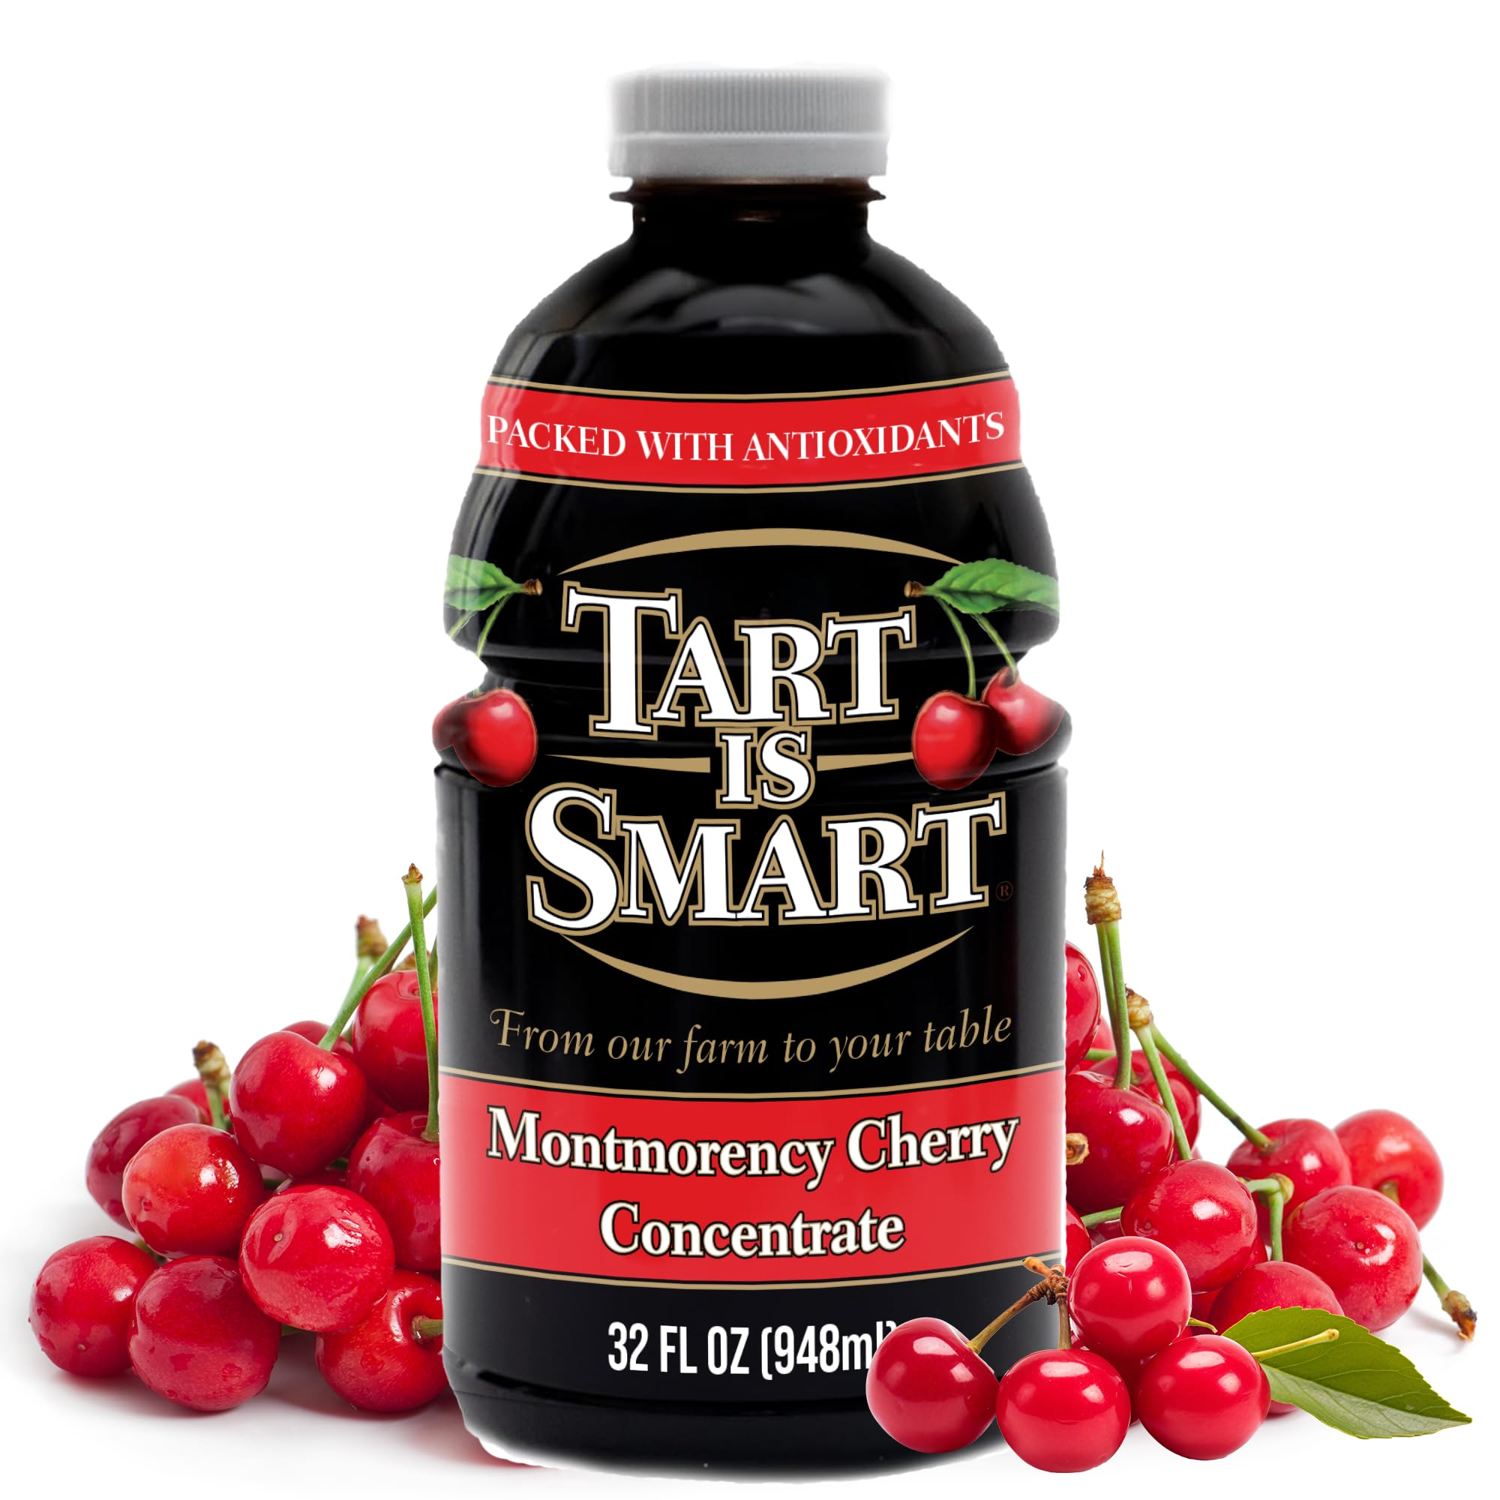
Sleep-Promoting Foods and Nutrients⁴
Melatonin
  Kiwi, unsweetened Montmorency tart cherry juice, and walnuts
Magnesium
  Spinach, pumpkin seeds, chia seeds, almonds
Omega-3 fatty acids
  Salmon, herring, sardines, mackerel, tuna, trout

Slide 6

Evening Meal
Choose:
High fiber
Heart-healthy fat
Lean protein
Smaller portions*
Avoid:
Fried foods
Added sugar
Alcohol and caffeine
Notes:
Evening meal should be lighter. Largest meal should be breakfast and/or lunch

Slide 7

Dietary Supplements
Melatonin
> 10 mg/day of immediate release formula for >12 weeks shown to improve self-reported sleep quality in PD⁵
Lack of evidence for other supplements – Focus on diet quality and whole foods!
Always consult with physician and pharmacist prior to starting a new supplement.
Notes:
Meta-analysis of 5 Randomized Controlled Trials

Slide 8
References
Factor SA, McAlarney T, Sanchez-Ramos JR, Weiner WJ. Sleep disorders and sleep effect in Parkinson’s disease. Mov Disord. 1990;5:280–285. doi: 10.1002/mds.870050404.
Menza M, Dobkin RD, Marin H, Bienfait K. Sleep disturbances in Parkinson's disease. Mov Disord. 2010;25 Suppl 1(Suppl 1):S117-S122. doi:10.1002/mds.22788
Amara AW, Wood KH, Joop A, Memon RA, Pilkington J, Tuggle SC, Reams J, Barrett MJ, Edwards DA, Weltman AL, Hurt CP, Cutter G, Bamman MM. Randomized, Controlled Trial of Exercise on Objective and Subjective Sleep in Parkinson's Disease. Mov Disord. 2020 Jun;35(6):947-958. doi: 10.1002/mds.28009.
St-Onge MP, Mikic A, Pietrolungo CE. Effects of Diet on Sleep Quality. Adv Nutr. 2016;7(5):938-949. 2016 Sep 15. doi:10.3945/an.116.012336
Iftikhar S, Sameer HM, Zainab. Significant potential of melatonin therapy in Parkinson's disease - a meta-analysis of randomized controlled trials. Front Neurol. 2023;14:1265789. 2023; doi:10.3389/fneur.2023.1265789

Slide 9

Thank You!
Questions?
Christine Ferguson, PhD, RD, CSG
cfergus2@uab.edu

