Slide 1

Driver Rehabilitation
Karen Allen Hislop, OTR/L, CDRS
Therapy Achievements
karen@therapy-a.com

Slide 2

I Have the Best Job in the World!
For over 30 years, I have had the privilege of helping people re-gain the ability to function independently and drive after Parkinson's Disease, CVA, TBI, SCI and lymphedema.

Slide 3
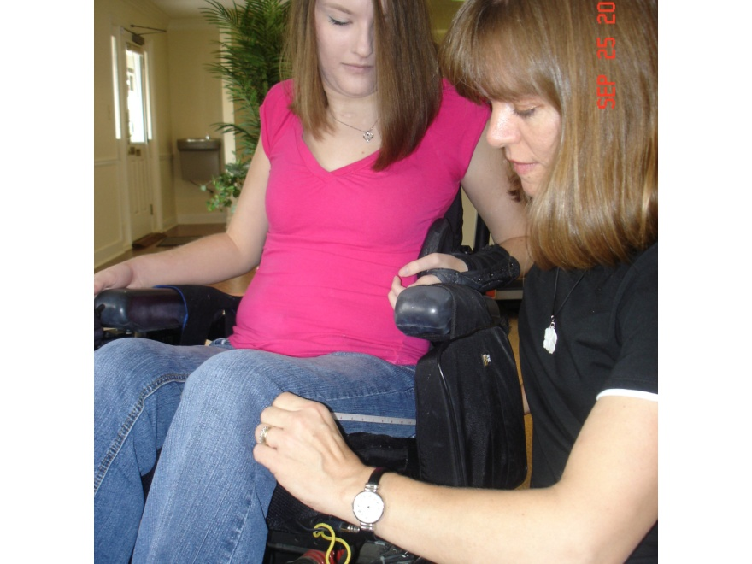
Therapy Achievements
In 2009 I formed Therapy Achievements
with the goal of helping people reach
their potential through specialized
therapy services and use of Adaptive
Technology.
Programs we provide include:
  Neuro Rehab: Brain & Spine
  Ortho Rehab: Bones, Joints & Muscles
  Lymphedema: Skin & Tissues
  Driving Rehabilitation

Slide 4
Driving Rehabilitation
What is a Driving Rehabilitation Specialist?

Slide 5
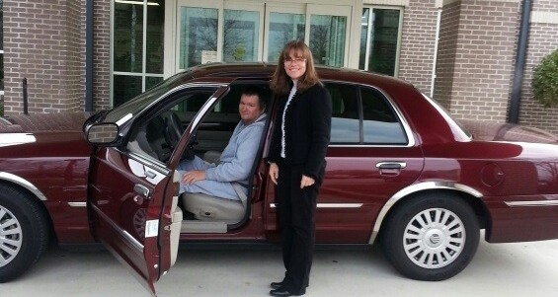
Driving Rehabilitation Specialist
I help individuals with disabilities attain safe, independent driving and transportation
I provide training in driving strategies and the use of adaptive driving equipment.

Slide 6

ADED ensures Driver Rehabilitation professionalism:
Provide a standard for driver rehabilitation – Best Practices
Provide credentialling to recognize those who meet the requirements. Credentialling has several tiers.
Provide education and research support
Work with equipment dealers to develop equipment and technology to maximize the transportation options for persons with disabilities

Slide 7
Components of Driving Safety
Michon’s Hierarchy of Driving Behavior

Slide 8

Operational Level
The ability to operate the vehicle:
To transfer into a vehicle, turn it on, and operate the steering, gas and brake.
Requires vision, ROM, strength.
Is an over learned driving skills with limited cognitive demand.
Impairments at this level can often be compensated for with adaptive equipment.

Slide 9
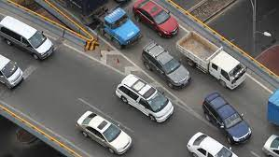
Tactical Level
The ability to negotiate roadways and interact with traffic:
Requires decisions about how to respond to the environment - when to slow down, how fast to go through a curve, when to start a turn, how much room to give people
Impairments at this level are reflected in fender benders & scrapes, difficulty with parking.

Slide 10
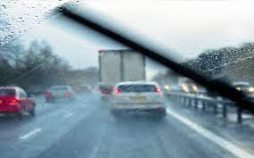
Strategic Level
The ability to way find, navigate and make risk reduction decisions:
Requires insight, strategy and planning - decisions about avoiding dark/weather/traffic, choosing a different route based on conditions
Drivers with Impairment at this level have high risk of crash

Slide 11
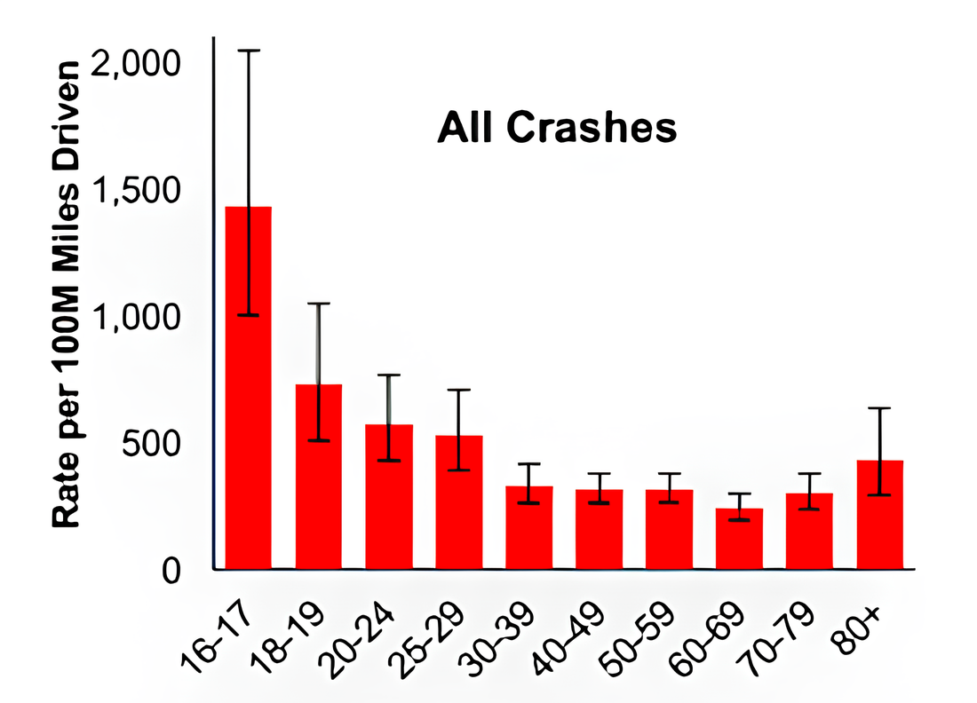
Who Is At Risk?

Slide 12
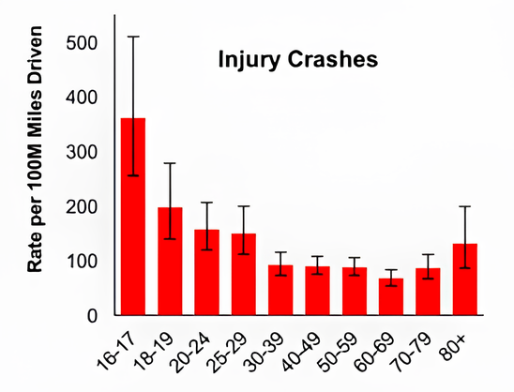
Who Is At Risk?

Slide 13
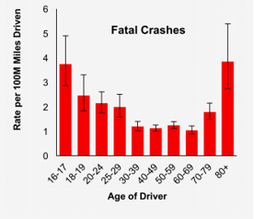
Who Is At Risk?

Slide 14

Who’s At Risk?
Studies of older drivers OR drivers with early stages of dementia:
Vision impairment had the most negative effect on driving performance
Cognitive age not chronological age was best predictor of who would drive safely

Slide 15
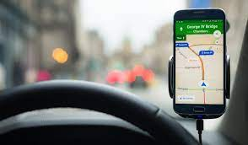
Who’s At Risk?
  Drivers who retained way finding continued to drive safely:
  way finding errors indicated participants were no longer safe to drive
  those who did poorly on self-navigation were much more likely to have an accident

Slide 16

How to Tell Who’s At Risk?
No cognitive test predicted who would have way finding errors
Different dimensions of cognitive function predicts different dimensions of driver safety:
  Processing speed predicted safety errors by not way finding
  Trails B predicted way finding errors but not safety errors

Slide 17
Best Practices
Evaluation

Slide 18

Clinical Assessment
Medical History /
Medical Status
  Medical History
  Medications
  Driving History / License status
  ADL status
  Driving goals

Slide 19

Clinical Assessment
Cognition
  Insight / Awareness
  Memory
  Speed of Processing
  Sustained and Divided Attention

Slide 20
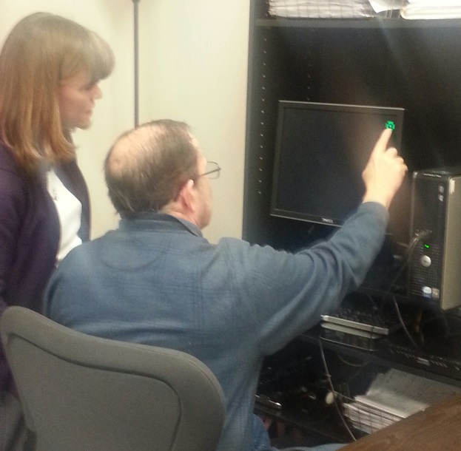
Clinical Assessment
Visual Assessment
  Visual Acuity
  Field of Vision
  Visual Skills: Tracking, Contrast

Slide 21
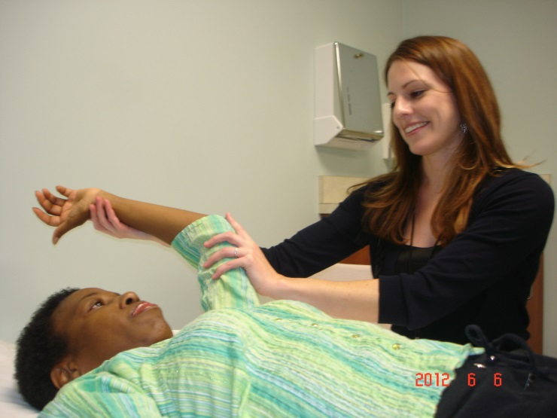
Clinical Assessment
Physical Assessment
  Range of Motion / Strength / Coordination
  Sensation / Proprioception
  Coordination / Reaction Time
  Dynamic Sitting /Transfers / Functional Mobility / Balance
  Devices

Slide 22
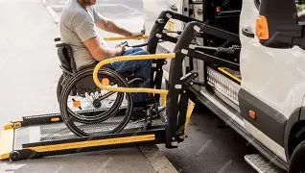

Equipment Assessment
Assess ability to enter and exit vehicle,
stow or secure equipment
Assess Positioning needs,
ability to maintain sitting

Slide 23
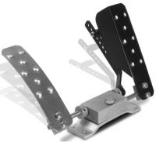
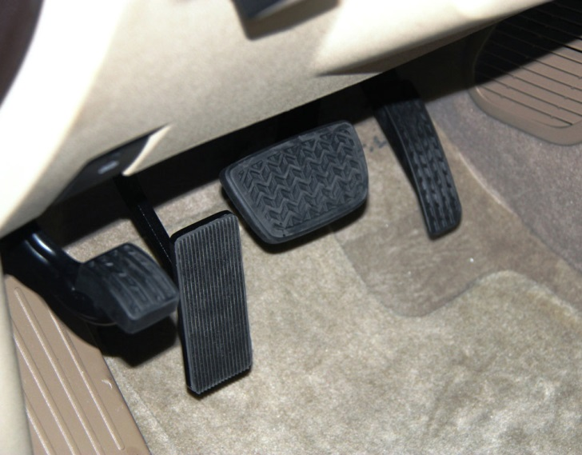
Equipment Assessment
  Assess ability to operate Primary Controls: Gas / Brake
    Left Gas Accelerator

Slide 24
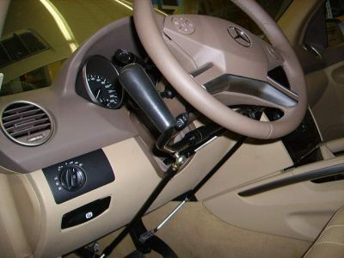
Equipment Assessment
Assess Primary Controls: Gas / Brake
    Left Column Mounted Hand Controls:
      Push / Rock
      Push / Pull
      Push / Twist

Slide 25
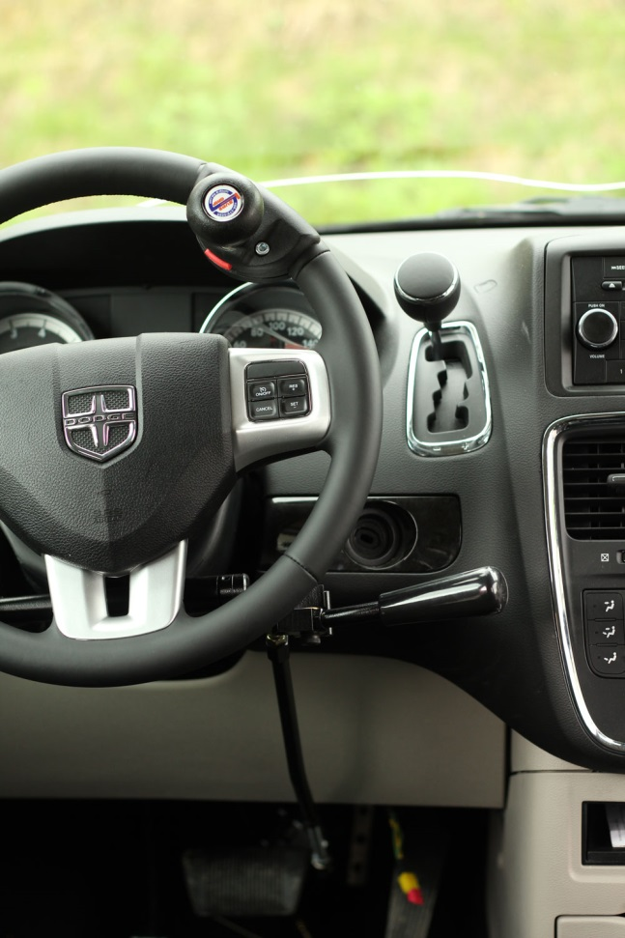
Equipment Assessment
Assess Primary Controls: Gas / Brake
Right Column Mount Hand Controls;
Push/Rock
Push/Pull
Push/Twist

Slide 26
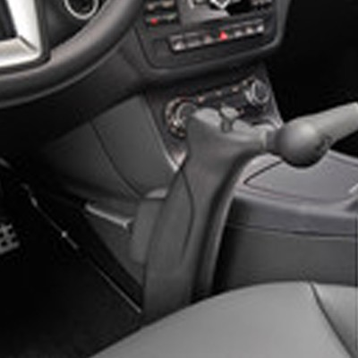
Equipment Assessment
Assess Primary Controls: Gas / Brake
Right Floor Mount Hand Controls:
Push/Rock
Push/Pull
Push/Twist

Slide 27
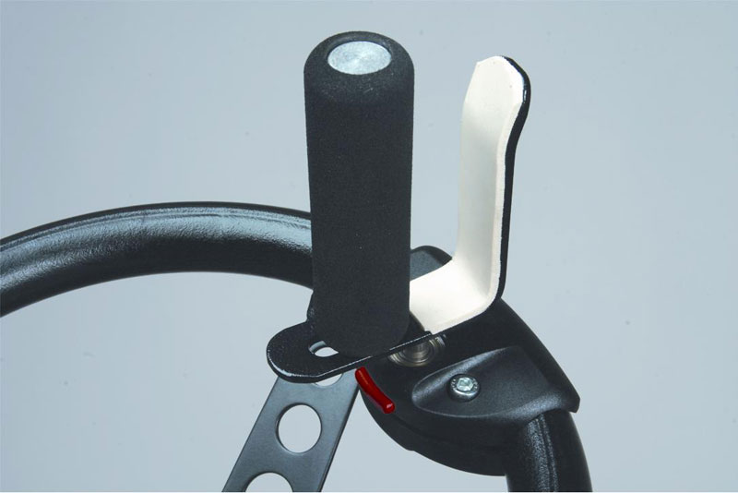
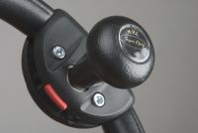
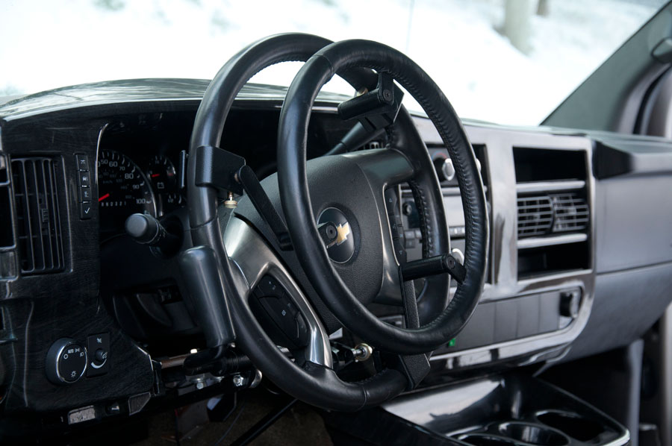
Equipment Assessment
Assess Primary Controls: Steering

Slide 28
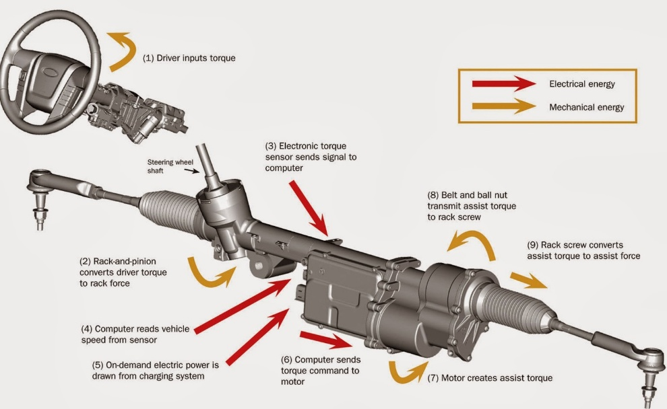
Equipment Assessment
    Assess Primary Controls:
    Power Assist Steering
Standard factory power steering requires approximately 40 ounces of effort to operate.
Drive-Master’s steering modifications can reduce the required effort to 20-24 ounces (low effort) or 6-8 ounces (no effort).

Slide 29
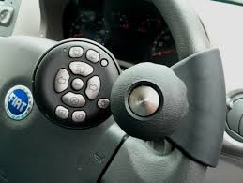
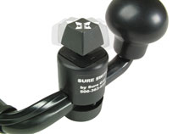
Equipment Assessment
  Secondary Controls: Signals, Wipers, Headlights
This remote can be used to control turn signals, wipers and washers, horn headlights and dimmer.

Slide 30

Behind-the-Wheel Evaluation
Speed Control:
Maintains appropriate speed through straightway, turns, traffic
Lane Control:
maintaining proper lane position through straightway and turns

Slide 31
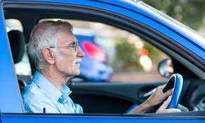
Behind-the-Wheel Evaluation
Attentions and Awareness:
attention to traffic, awareness of traffic conditions around him, ability to focus attention on the driving task for the duration of the evaluation
Memory:
memory for getting to and from familiar locations

Slide 32
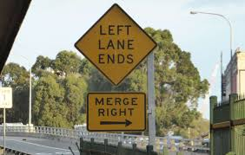
Behind-the-Wheel Evaluation
Judgement and Timing:
timing when completing lane changes and merges
maintaining proper distance with the cars ahead
adjusting speed based on traffic conditions,
anticipating upcoming traffic conditions (slowed when sees brake lights ahead, changes lanes when he sees pedestrians ahead)
Safety / Fatigue

Slide 33
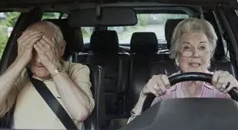
To Drive or Not to Drive?
Can you drive safely?
Con you drive safely with more training?
Can you drive safely with restrictions?
Should you retire from driving?
If you retire from driving, what is your transportation plan?

Slide 34
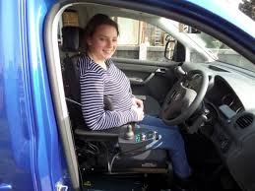
Behind-the-Wheel Training
Set goals
Provide training to meet goals
Adjust goals

Slide 35

Restricted Driving
Identify where you need to go
Identify routes you safely take yourself and routes you will not take by yourself
Identify transportation alternatives

Slide 36
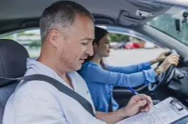
Re-Evaluation
Identify how often you will be re-tested

Slide 37

Driving Retirement
Identify how you will get to the places you need to go

Slide 38

Coverage
The clinical portion of the evaluation is covered by health insurance if the client has a “billable diagnosis” – a diagnosis that insurance pays for therapy to treat.
The On-The-Road portion of the evaluation and training is typically not covered by insurance and is an out-of-pocket expense.

Slide 39

Documentation
The client and the referring physician receive a report that states:
  Clinical test scores and performance
  Driving performance
  Training provided
  Competence in use of adaptive equipment
  Recommendations

Slide 40

Protection from Liability
Completing a Driving Evaluation protects you from liability. You have documentation stating you are competent to drive.

Slide 41

Skills for the Job of Living
Completing a Driving Evaluation helps you drive safely as long as possible. It helps you maintain skills for the job of living!

